Slide 1

Books
DSCI 1302
Ruqayyah Muse

Slide 2
About the Project
Books are a 25-billion-dollar industry* in the US alone, and there is a community dedicated to reading, reviewing, and promoting books.
This project looks at a dataset of 11,127 books and uses this data to analyze the trends between authors, ratings, and reviews.
*U.S. Book Industry - statistics & facts | Statista

Slide 3
The Data
11,127
Attributes List:
Book ID
Title
Authors
Average Rating
ISBN
ISBN 13
Language Code
Num Pages
Ratings Count
Text Reviews Count
Publication Date
Publisher
The Ones Used:
Book ID
Title
Authors
Average Rating
ISBN
ISBN 13
Language Code
Num Pages
Ratings Count
Text Reviews Count
Publication Date
Publisher
ENTRIES
12
ATTRIBUTES

Slide 4
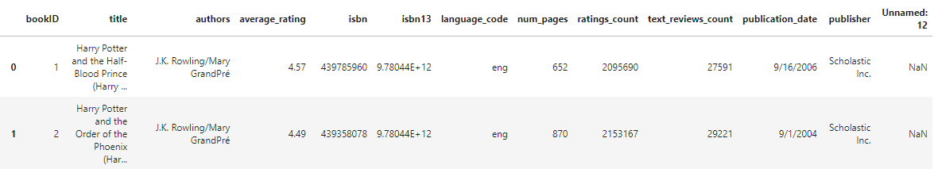
Cleaning the Data
Firstly, I checked for any null values so I could just delete that right away. There was an extra column titled Unnamed: 12 that was added to the data, causing null values for almost every row. I dropped that column entirely since I didn’t need it.
Secondly, some of the authors had multiple authors listed, separated by a back slash. Just to make it easier to analyze the data, I deleted all the coauthors and kept the first author listed.
Thirdly, all the values were in string while I need integers and floats, so I changed the data type of average_rating to float, and num_pages, ratings_count, and text_reviews_count to integer.
Fourthly, I deleted all rows where the average_rating and the ratings_count was 0. I only wanted to work with data that had an average_rating, and if a book has an average_rating, then it must have at least 1 ratings_count.

Slide 5
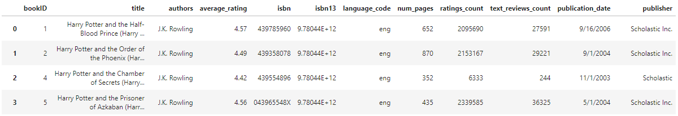
The Cleaned Data
11,044
12
ENTRIES
ATTRIBUTES

Slide 6
Breakdown of the Data
Ratings Count
18,071.2
765.5
12,744,279,295.5
112,890.6
MEAN
MEDIAN
VARIANCE
STANDARD DEV
Text Reviews Count
545.9
48.0
6,684,345.4
2,585.41
MEAN
MEDIAN
VARIANCE
STANDARD DEV

Slide 7
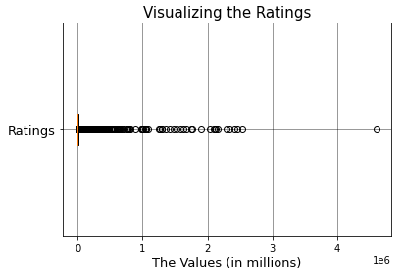
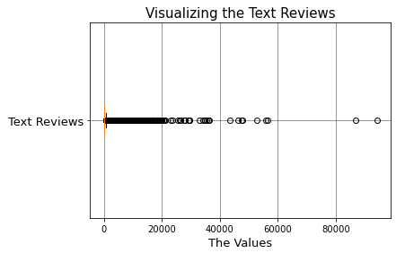
Boxplot of the Ratings & Reviews

Slide 8
Questions To Be Answered
Is there any correlation between the average ratings and page lengths?
Which authors appear the most frequently in the data?
Which books are the most popular?
How do the number of ratings and reviews compare to one another?

Slide 9
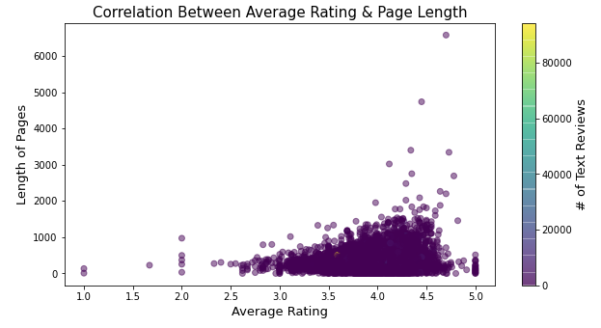
Is there any correlation between the average ratings and page lengths?
Possibly. It seems that as the length of the book increases, its average rating goes higher as well. The longer books generally have an average rating higher than 4.

Slide 10
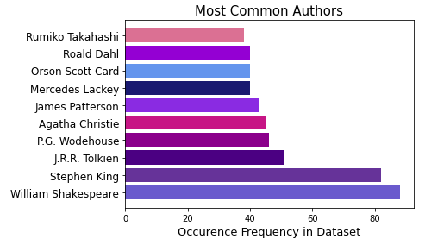
Which authors appear the most frequently in the data?
Shakespeare leads the list of most common authors, with 88 of his works included in this dataset.

Slide 11
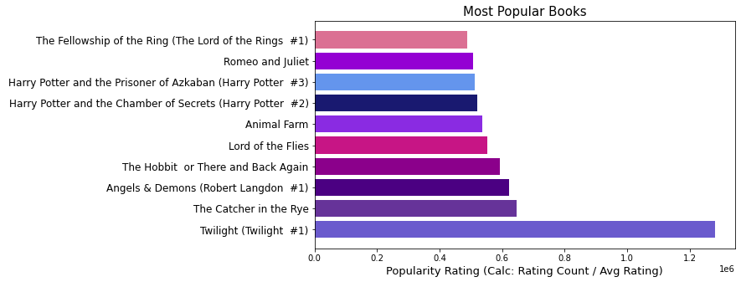
Which books are the most popular?
Twilight by Stephanie Meyer is by far the most popular book.

Slide 12
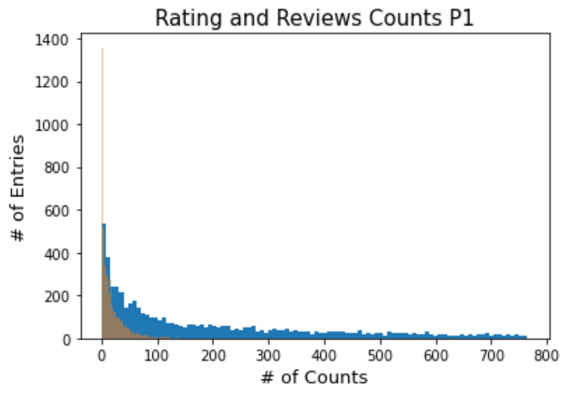
How do the number of ratings and reviews compare to one another?
At the start, the text reviews is tall since entries with a text review count of 0 were kept whereas review counts had to start from 1. Once the two graphs overlap, you can see that review counts were generally lower than rating counts.

Slide 13
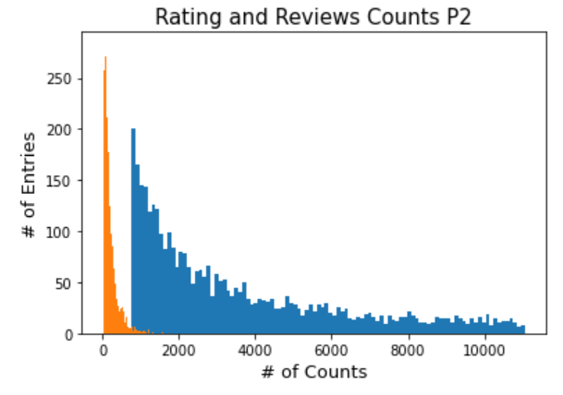
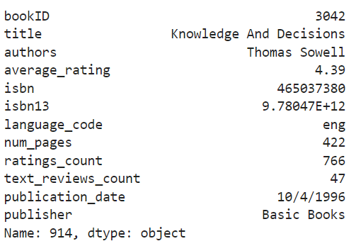

Slide 14
To Conclude
Is there any correlation between the average ratings and page lengths? Possibly.
Which authors appear the most frequently in the data? Shakespeare was the most frequent.
Which books are the most popular? Twilight was the most popular.
How do the number of ratings and reviews compare to one another? Reviews are generally less compared to ratings.

Slide 15
Source
https://www.kaggle.com/jealousleopard/goodreadsbooks

